Slide 1
Chocolate
Dairy milk vs kitkat

Slide 2
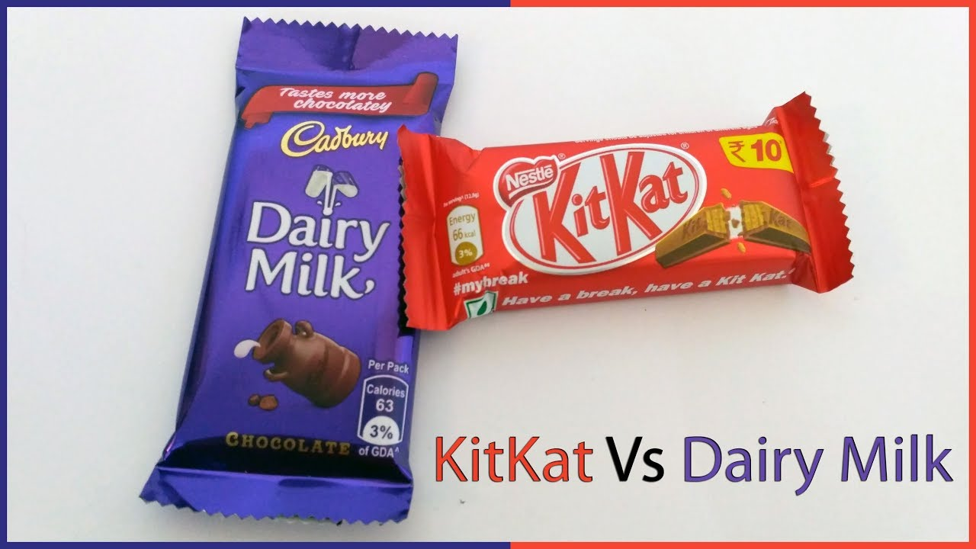

Slide 3
Dairy milk : History
Dairy Milk was launched in June 1905. It was sold in unwrapped blocks that could be broken down into penny bars. Gradually it became more and more successful, until it was Cadbury's biggest seller by the beginning of the First World War. By the early 1920s it had taken over the UK market.

Slide 4
Kitkat : History
The Kit Kat was developed in the mid 1930s when an employee from confectionery company, Rowntree in the UK, decided the world needed a chocolate bar that a man could take to work in his pack. The name Kit Kat was taken from a London- based literary club run by pastry chef Christopher Caitling in the late 17th Century

Slide 5
Overview of chocolate
The Indian chocolate market is projected to register a CAGR of 8.12% during the forecast period (2022-2027).
The chocolate market was negatively impacted by COVID-19. For example, Mars Incorporated witnessed a revenue degrowth of 30-50% in the first quarter of FY 2020 due to the closures of retail shops, hypermarkets/supermarkets, and conventional stores. Therefore, the sales of chocolate through offline channels sank drastically. However, the consumers’ in-home consumption of chocolates witnessed a steep rise (10-15%). Chocolates were bought in bulk, which led to higher volume sales through supermarkets and hypermarkets.

Slide 6
Comparison of diary milk and kitkat
Which chocolate do you like more - Kitkat or Cadbury Dairy Milk and why?
cadbury dairy milk has original Cocoa butter. Which is the most expensive fat in food industry. Though it doesn't give cocoa butter in low priced chocolate products.
Whereas kitkat uses Cocoa butter derivatives.
To experience this take a piece of both the chocolate and rub it between the tongue and pallet, if the chocolate melt as soon it is rubbed it can be concluded that there is presence of original Cocoa butter.

Slide 7
Benifits of dairy milk
cadbury dairy milk has original Cocoa butter. Which is the most expensive fat in food industry. Though it doesn't give cocoa butter in low priced chocolate products.
Whereas kitkat uses Cocoa butter derivatives.
To experience this take a piece of both the chocolate and rub it between the tongue and pallet, if the chocolate melt as soon it is rubbed it can be concluded that there is presence of original Cocoa butter.

Slide 8
Benefits of kitkat
Kit Kat chocolates are a quick source of carbohydrate,and help ward off hunger. Since Kit Kat has layers of milky chocolate, it is high in calories and sugar content and should be eaten in moderation. Else, it may cause dental caries.

Slide 9
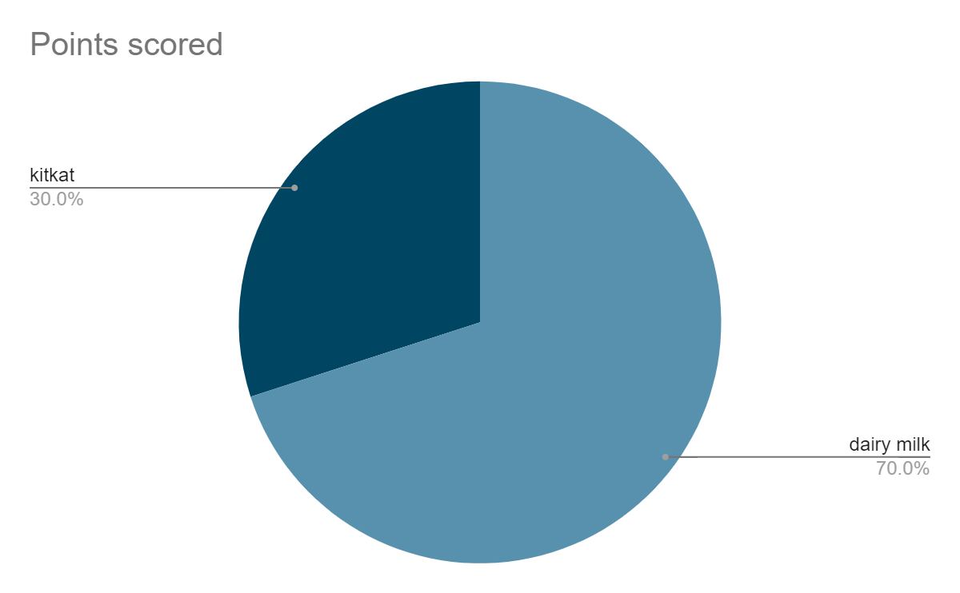
Marketing survey

